Slide 1
NE555 Timer

Slide 2
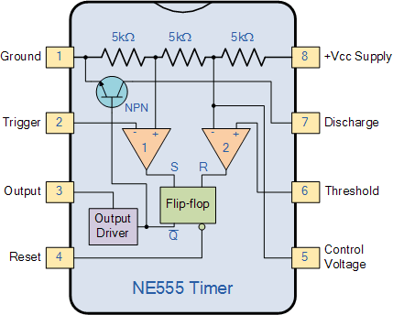
NE555 Block Diagram #1

Slide 3
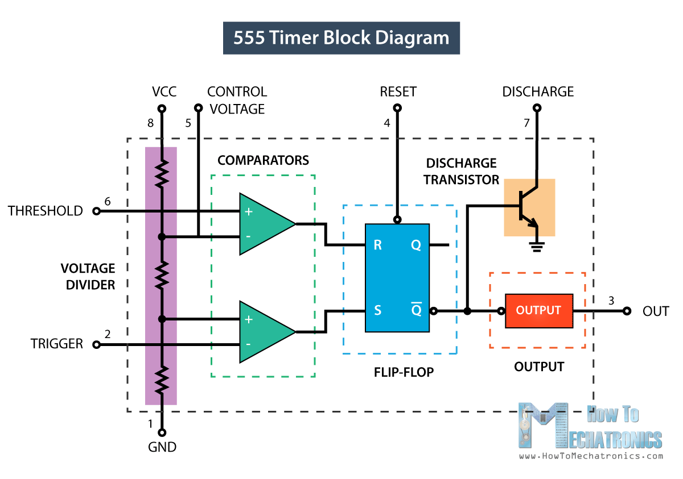
NE555 Block Diagram #2

Slide 4
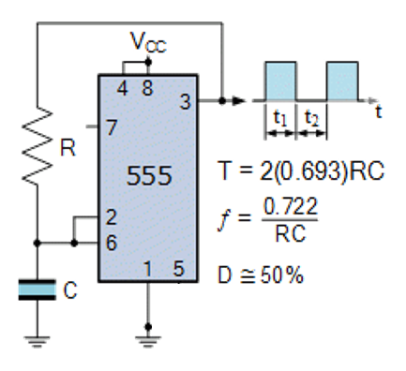
Simple NE555 Oscillator

